Slide 1


Slide 2


Cancer Medical Center Managment System
Presented by Hicham Baydoun

Slide 3
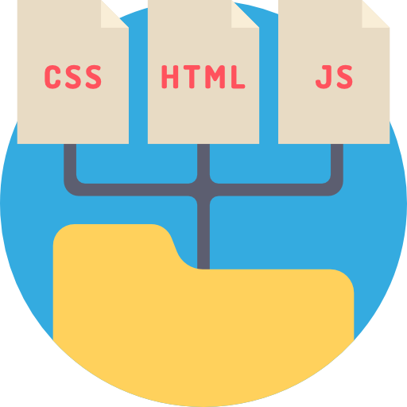




Slide 4
Content Summary
1) The Main Objective of the System
2) Who are the users?
3) Discuss about the users
4) What are the advantages of the System and why to use it?
5) Is it original?
6) Questions and Suggestions

Slide 5


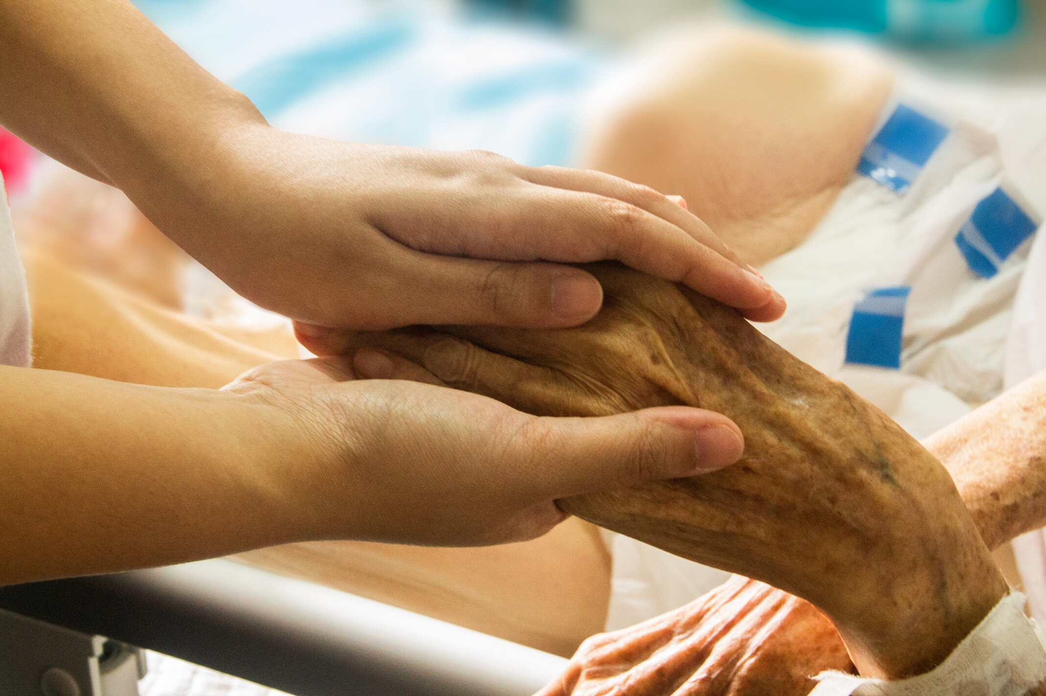
The Main Objective
It is simply to HELP cancer patients in their treatment journey.

Slide 6



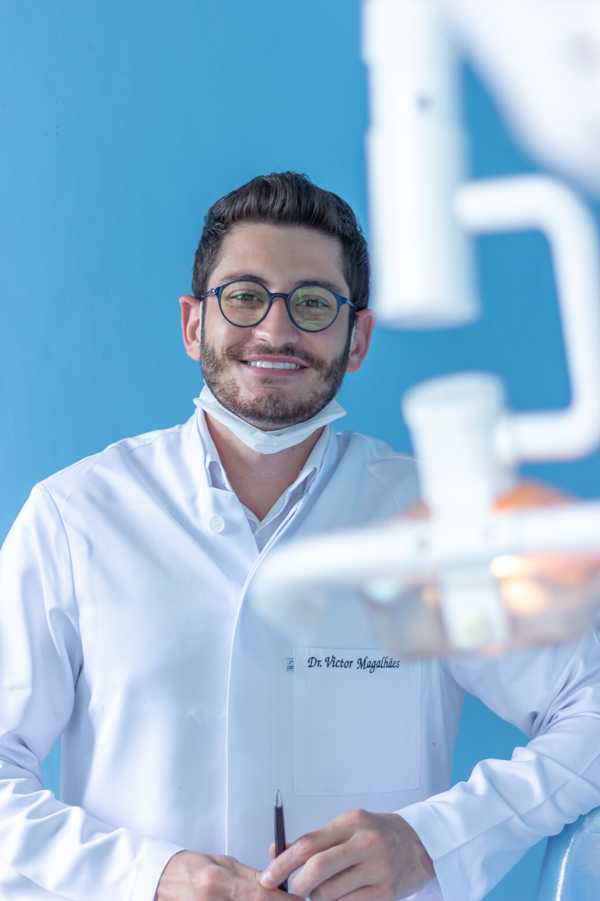



Who are the Users?
Patients
The Admin
Doctors
Supporters
Volunteers

Slide 7




Signup / Login
View Profile
Patients
Find Doctors

Slide 8




Make/ View/Cancel Appointments
Download reports
Patients
Issue Complaints
Volunteers

Slide 9


Login
View Profile
Doctors
Upload / Modify/ View Diagnosis and Notes

Slide 10


View Patients' History
View/ Cancel
Appointments
Doctors
Upload medical reports

Slide 11





The Admin
Add Doctors / Patients
Update/ Modify/ Edit Doctors’ and patients’ information
View all registered users

Slide 12


The Admin
View made Appointments
View / Modify his profile
View Complaints

Slide 13





Volunteers

Slide 14





Supporters

Slide 15
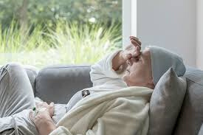


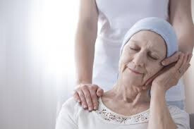

Extreme Fatigue
Depression
Anxiety

Slide 16


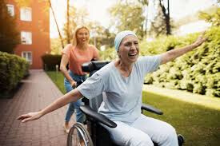
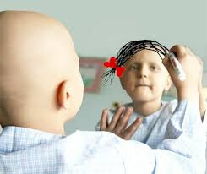
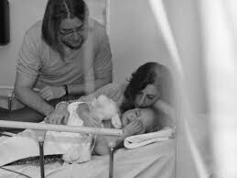
Registered ✅
Easy Experience
Simple for children and their Families

Slide 17




Time Consuming
Frustrating
Data are Lost

Slide 18


Database
Data are saved and safe

Slide 19




Slide 20



